Slide 1
Java Collections and Generics
1.0. Java collections hierarchy
1.1. understand what is collections
1.2. understand what is List interface and its classes
1.3. understand what is Map interface and its classes
1.4. understand what is Set interface and its classes
1.5 understand what is Queue interface and its classes
1.6. understand what is comparable and comparator interface
1.7. understand what is iterator interface
1.8. understand the importance of java generics

Slide 2
What is java Collections?
The Collections in java is a framework that has a set of classes and interfaces provided by java to handle collection of objects. It provides various data structures and algorithms to store and manipulate group of objects efficiently. The java Collections can achieve all the operations that you perform on a data such as searching, sorting, insertion, manipulation and deletion.
Java Collection means a single unit of objects. Java Collection framework provides many interfaces (Set, List, Queue, Deque) and classes (ArrayList, Vector, LinkedList, PriorityQueue, HashSet, LinkedHashSet, TreeSet).
Key components of the java collections framework includes :
1. interfaces :- these describe the abstract data types that represent collections, such as List, Set, Map, Queue etc.
2. class implementations :- these are the concrete implementations of the interfaces mentioned above, such as Arraylist, LinkedList, HashSet, HashMap, PriorityQueue. Etc.
3. algorithms :- these are steps or methods to performs useful computations, such as searching, sorting, shuffling, etc on collections.

Slide 3
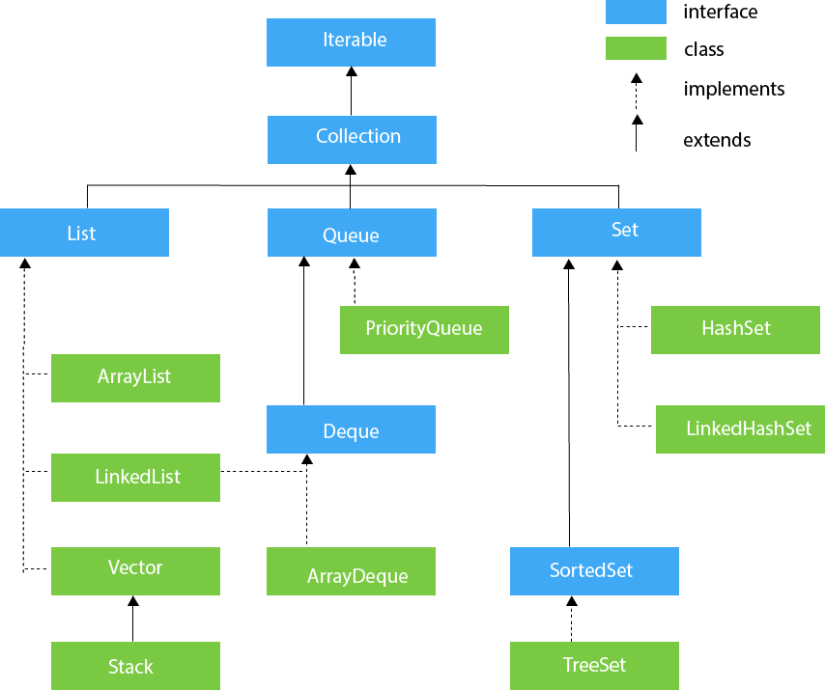
Collection Hierarchy

Slide 4
Java collections cont.
The Collection interface is the root of the hierarchy, it provides all general-purpose methods which all Collections classes support, it also extends the iterable interface that add support for iterating over the collection elements using the advanced for-each loop statement.
In summary the java Collection framework provides an architecture to store and manipulate the group of objects.
Let's breakdown Collection and Framework:
Collection :- represent a single unit of objects. That is a group.
Framework :- provides readymade architecture. It represents a set of classes and interfaces.
The Collection framework represents a unified architecture for storing and manipulating a group of objects. It has:
1. Interfaces and its implementations, i.e., classes
2. Algorithm

Slide 5
Java collections cont.
Methods of the Collection interface :
i. add(E e) -- it is used to insert an element into the collection.
ii. addAll(Collection<>c) -- it is used to insert the specified collection elements in the invoking collection.
iii. remove(Object element) -- it is used to delete an element from the collections.
iv. removeAll(Collection<>c) -- it is used to delete all the element of the specified collections from the invoking collection.
v. size() -- it returns the total number of elements from the collections.
vi. clear() -- it removes the total number of elements from the collections.
vii. contains(Object element) -- it is used to search for an element.
viii. ContainsAll(Collection<>c) -- it is used to search the specified collection in the collection.
ix. Iterator() -- it returns an iterator.
x. toArray() -- it converts collection into an array.
xi. IsEmpty() -- checks if collections is empty.
xii. Stream() -- it returns a sequential stream with collection as its source
xiii. equals() -- it matches two collections

Slide 6
Java collections cont.
What is the iterator interface ? :- the iterator interface provides the facility of iterating over the elements in forward direction only. It has 3 methods only: hasNext(), next(), and remove().
What is the List Interface ? :- the list interface is the child interface of the Collection interface, it has a list type data structure in which we can store the order collection of objects, it can also have duplicate values. List interface is implemented by the classes : ArrayList, LinkedList, Vector, Stack.
What is the Queue interface ? :- the queue interface maintains the First-In-First-Out (FIFO) order, it is an ordered list that is used to hold the elements which are about to be processed. Classes which implement the Queue interface are PriorityQueue, Deque, and ArrayDeque.
What is the Set Interface ? :- the Set interface represent unordered set of elements which does not allow us to store the duplicate items. Set is implemented by HashSet, LinkedHashSet and TreeSet classes.
What is Map interface ? :- is an interface that represents a collection of key-value pairs, where each key is unique. Each key and value pair is known as an entry. The Map interface provides methods for adding, removing and retrieving elements based on their keys. A Map cannot have duplicate keys but can have duplicate values. Classes that implements the Map interface are HashMap, LinkedHashMap, and TreeMap. Useful methods of the map interface are : 1.put(Object key, Object value) -- used to insert an entry into the map. 2. remove(Object key) -- used to delete an entry for the specified key. 3. get(Object key) -- this method returns the object that contains the value associated with the key. 4. isEmpty() -- it returns true if the map is empty, returns false if it contains atleast one key. 5. size() -- it returns the number of entries in the map.

Slide 7
Java collections cont.
What is an iterator in java ? :- an iterator is an interface provided by the java collections framework; it is used to iterate over elements in a collection which enables you to access each element without having knowledge of the underlying data structure.
Java iterator methods :
1. hasNext() -- this method returns true if there are more element left in the iteration, else it returns false.
2. next() -- it is similar to the hasNext(), in that it returns the next element. I.e the next element in the traversal.
3. remove() -- it removes the last element returned by the iterator traversing through the underlying collection.
Why use the java iterator? :- 1. the java iterator can be applied to any of the classes in the Collection framework. 2. if a user is working with a for loop, they cannot morderniz
e (add/remove) from the Collection, whereas with the java iterator Collections can be updated.
How to use the java iterator? -- class activity 1A
Points to Remember
The Java Iterator is used to iterate the components of the collection object one by one.
The Java Iterator also supports the operations like READ and REMOVE.
The methods names of the Iterator class are very simple and easy to use compared to the method names of Enumeration Iterator.

Slide 8
Java collections cont.
What is the java Queue interface? :- the java queue interface is part of the java Collections framework and represent a collection of elements with specific insertion and retrieval orders, which typically follows the first-in-first-out (FIFO) principle. In simple terms it represents a queue in real life, where element are added at the end and removed from the beginning. It is part of the java util package which extends the Collection interface. Being an interface, it means that it has to be implemented by a class and the most common classes are the PriorityQueue and LinkedList.
Queue interface declaration : Queue<E>
Methods of the java queue interface :
i. add(object) -- it is used to insert the specified element into this queue and return true upon success.
ii. offer(object) -- it is used to insert the specified element into this queue.
iii. remove() -- it is used to retrieves and removes the head of this queue.
iv. poll() -- it is used to retrieves and removes the head of this queue but return null if this queue is empty.
v. element() -- it is used to retrieves but does not remove the head of this queue.
vi. peek() -- it is used to retrieves but does not remove the head of this queue or returns null if this queue is empty.

Slide 9
Java collections cont.
Features of a Queue
FIFO concept is used for insertion and deletion of elements from a queue.
The Java Queue provides support for all of the methods of the Collection interface including deletion, insertion, etc.
PriorityQueue, ArrayBlockingQueue and LinkedList are the implementations that are used most frequently.
The NullPointerException is raised, if any null operation is done on the BlockingQueues.
Those Queues that are present in the util package are known as Unbounded Queues.
Those Queues that are present in the util.concurrent package are known as bounded Queues.
All Queues barring the Deques facilitates removal and insertion at the head and tail of the queue; respectively. In fact, deques support element insertion and removal at both ends.

Slide 10
Java collections cont.
What is java PriorityQueue class ? :- the priority queue class is an implementation of the Queue interface that provides a priority-based ordering for elements. Elements in a priority queue are ordered according to their natural ordering. The priority queue class give us a way to process element based on priority in that the element with the highest priority will be at the head of the queue and will be the first one to be removed.
Why should you use the java PriorityQueue class ? :- you should use the priority queue class when elements need to be processed based on some certain priority, for instance if a teacher and a student are trying to borrow same book title from a library, the teacher should be given a higher priority that the student no matter who asked for the book first.
NOTE : By default, priority queue are determined by the natural ordering of elements, default priority can be overridden by implementing a Comparable or Comparator provided at queue construction time.
How to use priority queue ? -- class activity 2A – let's see simple example of using priority queue
What is java Comparator ? :- the java Comparator interface is used to order the objects of a user-defined class, it contains a compare() method which compares two argument for ordering, it provides multiple sorting sequence which allows you to sort the data on the basis of any data member for ex id, age, name or anything else.
It offers a comparison logic which returns positive integer if the current object is greater than the specified object, negative integer if the current object is less than the specified object and zero if they are both equal.
Class activity 2B --- let's see how to use the java comparator to sort list of person based on their age the younger the age the quicker they will be attended to no matter what position they are in the queue.
Class activity 3A – putting all together -- let's see another class activity using priority queue and comparator to implement meal taken at Decagon cafeteria between female and male devs where the female has a higher priority of given the meal first even if the male dev gets to the queue first.

Slide 11
Java collections cont.
Class exercise 1A : using priority queue and comparator interface create a task that gives a higher priority to an older customer over a younger customer when both of them are on the queue. The older customer should be attended to first based on the priority of being older before the younger customer even if the younger customer gets to the queue first. but if all customers on the queue are young, then the first customer that gets to the queue first should be attended to on first-in-first-out basis (FIFO). Make sure to use proper design architecture for your code: model package to house all entity class, service package for all business logic implementation and enums package for all constant values.
What is java Comparable ? :- the Comparable interface is used to ordered the object of the user defined class, it contains only one method called compareTo(object) which provides a simple sorting sequence only, that is you can sort the element on the basis of a single data member only e.g id, name, score etc.. The compareTo() method is used to compare the current object with the specified object.

Slide 12
Java collections cont.
Differences between comparable and comparator :
1. comparable provides a single sorting sequence. while comparator provides multiple sorting sequence.
2. comparable modified the original class. Comparator does not modify the original class.
3. comparable provides the compareTo() method to sort elements. Comparator provides the compare() method to sort elements.
What is java HashSet ? :- is a class that implement the Set interface, which represents a collection of unique elements, it uses the hash table for storing the elements and does not guarantee the order of the elements.
Some key points about why you should use HashSet :
1. Unique elements :- `Hashset` does not allow duplicate element(s), if you try to add duplicate element it will be ignored.
2. Ordering elements :- the order of the elements are not guaranteed, it may change overtime.
3. performance :- the performance of basic operations like adding, removing and checking for the presence of an element is constant time (O)1), however in worst case scenerio all element hash to the same bucket leading to O(n) time complexity.
4. iteration :- iterating through the element of a hashset does not guarantee any particular order.
5. null elements :- hashset allows the insertion of a single null element.

Slide 13
Java collections cont.
One of the major difference between List and Set is that List can contain duplicate elements and Set contains only unique elements.
HashSet declaration:
HashSet<DATA_TYPE> hash = new HashSet<>()
HashSet methods :- all the Collections methods like add(), addAll(), remove(), isEmpty(), size() etc we mentioned in earlier slide also applies to the HashSet.
How to use java HashSet ? :- let's see how to use hashset to produce only unique elements
Class activity 4A -- Give a shot at it – to show you that all Collection classes are kind of following similar logic, use your knowledge of PriorityQueue -- but this time replace it with HashSet and add strings of numbers one to five, duplicate five to your hash set, iterate over it and print out the string of numbers. NOTE: Use the iterator interface to iterate over the set of items.
Class exercise 2A -- 1. create a Book entity with fields id, book title, book author, book quantity. 2. create constructors and getters. Override the default toString() method. 3. create a Main class and instantiate your book entity with five instances created. Using a HashSet add all instances of the book you instantiated and use an advanced for loop to iterate over the books and print out each book entry with the necessary details.

Slide 14
Java collections cont.
Java Map Interface
A map contains values on the basis of key, i.e. key and value pair. Each key and value pair is known as an entry. A Map contains unique keys.
A Map is useful if you have to search, update or delete elements on the basis of a key.
Java Map Hierarchy
There are two interfaces for implementing Map in java: Map and SortedMap, and three classes: HashMap, LinkedHashMap, and TreeMap. The hierarchy of Java Map is shown in the next slide:
A Map doesn't allow duplicate keys, but you can have duplicate values. HashMap and LinkedHashMap allow null keys and values, but TreeMap doesn't allow any null key or value.

Slide 15
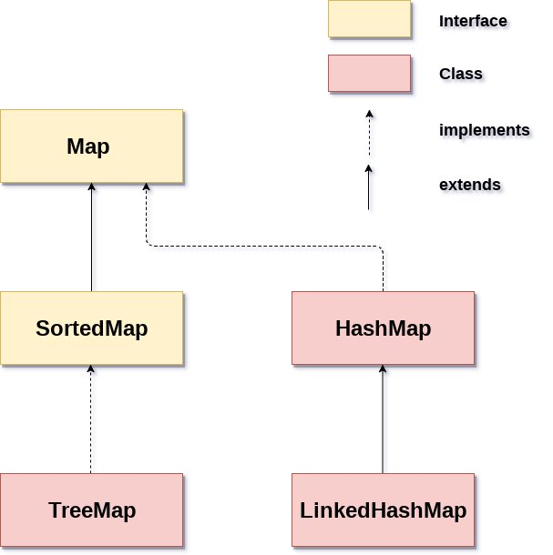

Slide 16
Useful methods of Map interface
V put(Object key, Object value) --- It is used to insert an entry in the map.
void putAll(Map map) --- It is used to insert the specified map in the map.
V remove(Object key) --- It is used to delete an entry for the specified key.
boolean remove(Object key, Object value) --- It removes the specified values with the associated specified keys from the map.
void clear() --- It is used to reset the map.
boolean containsValue(Object value) --- This method returns true if some value equal to the value exists within the map, else return false.
boolean containsKey(Object key) --- This method returns true if some key equal to the key exists within the map, else return false.
boolean equals(Object o) --- It is used to compare the specified Object with the Map.
V get(Object key) --- This method returns the object that contains the value associated with the key.
int size() --- This method returns the number of entries in the map.

Slide 17
Java collections cont.
What is java HashMap ? :- is a class that implements the Map interface, it provides a data structure to store the key-value pairs, where each key is associated with a corresponding value. The keys are always unique while the values can be duplicated. The HashMap class is found in the java.util package.
Points to remember :
1. it contains values based on the key.
2. it contains only unique keys.
3. It may have one null key and multiple null values.
4. it maintains no order.
5. it can contain duplicate values
HashMap class declaration :-
HashMap<K, V> map = new HashMap<>(); -- where K is the type of keys maintained by the map, and V is the typed of mapped values.

Slide 18
Java collections cont.
Methods of HashMap :
1. clear() -- it is used to removed all the mappings from this map
2. isEmpty() -- it is used to returned true if this mappings contains no key-value mappings
3. entrySet() -- it is used to returned a collection views of the mappings contained in this map.
4. keySet() -- it is used to returned a set views of the key contained in this map.
5. put(Object K, Object V) -- it is used to insert an entry into the map.
6. remove(Object K) -- it is used to delete an entry for the specified key.
7. containsValue(Object V) -- it is used to return true if some value is equals to the value which exist in the map, else return false
8. containsKey(Object K) -- it is used to return true if some key is equal to the key which exist in the map, else return false.
9. get(Object K) -- this method returns the object that contains the value associated with the key.
10. Size() -- this methods returns the number of entries in the map.
11. ContainsKey(Object key) -- this method returns true if some key equal to the key exists within the map, else returns false.

Slide 19
Java collections cont.
Class activity 5A – let's see how to use the java HashMap class and its related methods like put, remove, replace, containsKey, get etc.
The difference between HashSet and HashMap, is that HashSet contains only values, while HashMap contains keys and values
Class exercise 3A – : 1. create a Book entity with fields id, book title, book author, book quantity. 2. create constructors, getters and override the default toString() method. 3. create a Main class and instantiate your book entity with five instances created. Using a HashMap where Integer is the key and the Book entity is the value, map five instances of the book you instantiated and use an advanced for loop to iterate over the key, value pairs and print out each book entry with the necessary details. User proper model package.
Class exercise 3A1 : peer-to-peer – Pls read carefully and follow instruction: Exercise Description: You're tasked with creating a simple program to track the grades of students. Each student has a unique ID (integer) and a corresponding grade (double). You'll use a HashMap to store this information, where the student ID is the key and the grade is the value.
Tasks:
1. Create a Java class called GradeTracker.
2. Inside the GradeTracker class, create a HashMap to store the student grades. Use Integer as the key type (for student ID) and Double as the value type (for student grade).
3. create a no defalult constructor and instantiate the hashmap.
3. Create a method named addGrade that takes two parameters: studentID (int) and grade (double). This method should add a new entry to the HashMap with the provided student ID and grade.
4. Create a method named getGrade that takes studentID as a parameter and returns the grade associated with that student. Edge case - If the student ID is not found in the HashMap, return –1.0.
5. Create the main class and create an instance of GradeTracker.
6. Add at least three student grades using the addGrade method.
7. Test the getGrade method by retrieving and printing the grades of the added students.

Slide 20
Java collections cont.
What is java List :- List in java provides the interface to maintained the ordered collection. It contains indexed based methods to insert, update, delete and search the elements. List can contain duplicate elements as well as store null elements. The List interface is found in the java.util package which inherits the Collection interface. The classes that implement the List interface are : ArrayList, LinkedList, Stack, Vector. The ArrayList and LinkedList are widely used, the Vector is now deprecated since java 5.
Java List methods :
1. add(E e) -- it is used to append the specified element at the end of the list
2. clear() -- it is used to remove all of the elements from the list.
3. equals(Object o) -- it is used to compare the specified object with the element of the list.
4. get(E index) -- it is used to fetch the element from the particular position of the list.
5. isEmpty() -- it returns true if the list is empty, otherwise false.
6. toArray() -- it is use to return an array containing all the elements in the list
7. contains(Object o) -- it returns true if the list contain the specified element.
8. indexOf(Object o) -- it is used to return the index of the current list of the first occurrence of the specified element, or –1 if the list does not contain this element.
9. remove(int index) -- it is used to remove the element present at the specified position in the list.
10. Size() -- it is used to return the total number of elements present in the list.

Slide 21
Java collections cont.
How to create List ? :-
1. List<String> list = new ArrayList<>(); -- this create a list of type String using ArrayList.
2. List<String> list = new LinkedList<>(); -- this create a list of type String using LinkedlList.
Class activity 6A – how to use a List using Arraylist and LinkedList example with some methods
Class activity 7A – let's see an example on how to convert an Array into a List
Class activity 8A – let's see an example to convert List to an Array
Class exercise 4A – write a program to sort a list of numbers using ArrayList. The numbers should be added to the list as 50, 30, 70, 40, 10 in that other, after which you should sort and use a for loop to print out the number from smallest to highest.
Class exercise 5A -- 1. Using LinkedList create a Book entity with fields id, book title, book author, book quantity. 2. create constructors and getters. 3. create a Main class to instantiate the book entity and create five instances. Using a List add five instances of the book entity and use a for loop to iterate over the book entity and print out each book entry with the necessary details.
Differences between ArrayList and LinkedList:
1. ArrayList internally uses a dynamic array to store the elements. While LinkedList internally uses a doubly linked list to store the elements.
2. manipulation with ArrayList is slow because it internally uses an array. While manipulation with LinkedList is fast due to internally uses a doubly linked list.
3. an ArrayList can act as a List only because it implements List interface only. While a LinkedList can act as both a List and queue because it implement List and deque interface.
4. ArrayList is better for storing and manipulating data. While LinkedList is better for manipulating data

Slide 22
Java Generics
What is java Generics? :- it provide a way to create classes, interfaces and methods that operate on different types while maintaining type safety at compile time. Generics were introduced in java 5 to enhanced code readibility, reuseability, type safety. Generics helps makes our code stable by helping to detect bugs at compile time.
Why do we use Generics? :
1. type parameters :- Generics introduced type parameters which are placeholders for types like (Integer, String) etc. This type parameters are specified within brackets<> when declaring a generic class, interface or method. This help with type safety. Without generics we can just store any type of objects, which leads to confusion.
Class activity 9A – let's quickly see an example without using generics
2. type casting is no longer required
3. compile time checking – it is check at compile time so as to avoid any run time error which is a good programming strategy.
Syntax:
ClassOrInterface<T> ----
ArrayList<String> -- for class
List<String> -- for interface
Type parameters – the type parameters naming convention are important to learn generics thoroughly. The common type parameters are : T - Type, E - Element, K- Key, V- Value, N - Number

Slide 23
Java Generics
Generic method :- Like generic class we can create generic methods that can accepts any types of arguments. Here, the scope of argument is limited to the method where it is declared, it allows static as well as non-static methods.
Class activity 10A – let's see an example how to use generics with methods:
Class activity 11A – let's see an example how to create a generic class:
END OF CLASS!!!

